Slide 1
DATA science in a networked era
Noemi Derzsy

Slide 2
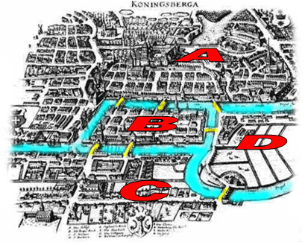
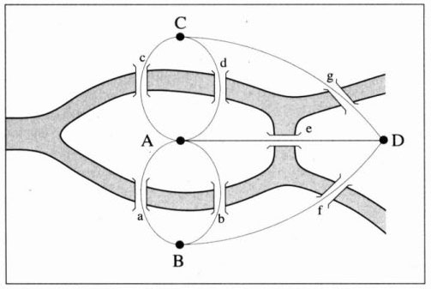
Graph theory
Leonhard Euler: Seven bridges of Konigsberg (1735)
The problem: find a path to walk over the 7 bridges in Köngisberg
(each bridge can be passed only once!)
Conditions: 1. the number of bridges touching the islands must be even
2. none or two nodes of odd degree
Depends on the nodes’ degree (number of edges one node has)
NO solution!
The theorem in the Königsberg bridges problem is the first graph theorem . The most important information: the number of edges and the nodes that are connected. This observation founded the development of mathematical topology.

Slide 3
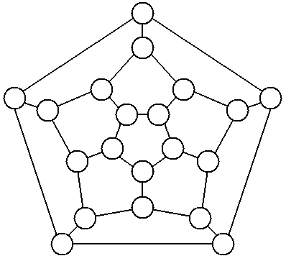
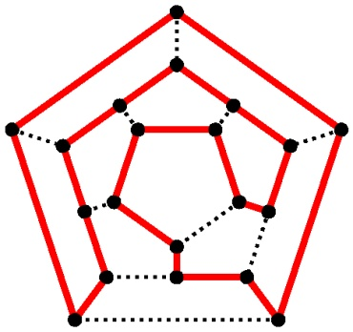
Graph theory
William Rowen Hamilton: Icosian game (1856)
The problem: walk over the entire dodecahedron, in a cycle, touching each node only once having the ending node in the starting one
The solution: is a path with twenty edges
Hamiltonian path
The Icosian game defined a very important research topic in graph theory: finding a route in a graph that walks over the system in the most optimal way (passing through each node only once).

Slide 4
networks
A graph is an abstract representation of a set of objects connected by links G = {P,E}.
networks = large graphs
Complex systems can be studied through their underlying network structure: nodes (elements), links (interaction)
The way we assign the nodes and links, defines the problem and questions we can study
Basic structural properties
Degree distribution P(k): the probability that a randomly selected node in the network has k connections
Clustering coefficient:
Average path length: the average of the smallest distance between two randomly selected nodes
Diameter: the maximal distance between two elements in a graph
Centrality: the importance of a node relying on its position, the level of contribution an agent has in a network
And much more….

Slide 5
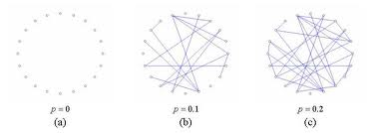
Random (ERDOS-renyi) networks
Degree distribution: Poisson distribution
Small clustering coefficient
High average path length
Model proposed by P. Erdős and A. Rényi
Problems of the model
Studies showed that real complex systems: do not have Poisson distribution!
Several clusters were observed in real complex systems that are not reproduced by this model
Presence of hubs in real complex systems
A DIFFERENT MODEL IS NEEDED!
P. Erdős, A. Rényi. (1959). On random graphs, I., Publ. Math. Debrecen 6.

Slide 6
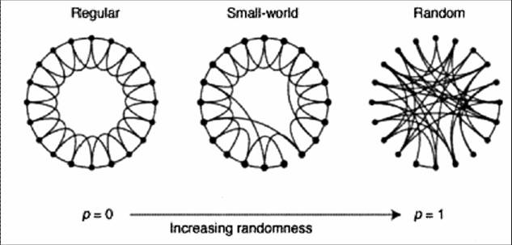
Small-world (watts-strogatz) networks
Problems solved
Studies showed that real complex systems: do not have Poisson distribution!
Several clusters were observed in real complex systems that are not reproduced by this model
Presence of hubs in real complex systems
Degree distribution: exponential
High clustering coefficient
Small average path length
Model proposed by
D.J. Watts and S.H. Strogatz
The model can’t reproduce it!
D. J. Watts, S. H. Strogatz.(1998). Nature (London) 393, 440

Slide 7
Scale-free (barabasi-albert) networks
Problems solved
Studies showed that real complex systems: do not have Poisson distribution!
Several clusters were observed in real complex systems that are not reproduced by this model
Presence of hubs in real complex systems
Degree distribution: power-law distribution
High clustering coefficient
Small average path length
Model proposed by
A.-L. Barabasi and R. Albert
preferential attachment (the model’s key ingredient)
R. Albert, A.-L. Barabási.(2002). Statistical mechanics of complex networks,Reviews of Modern Physics 74, 47-97.

Slide 8
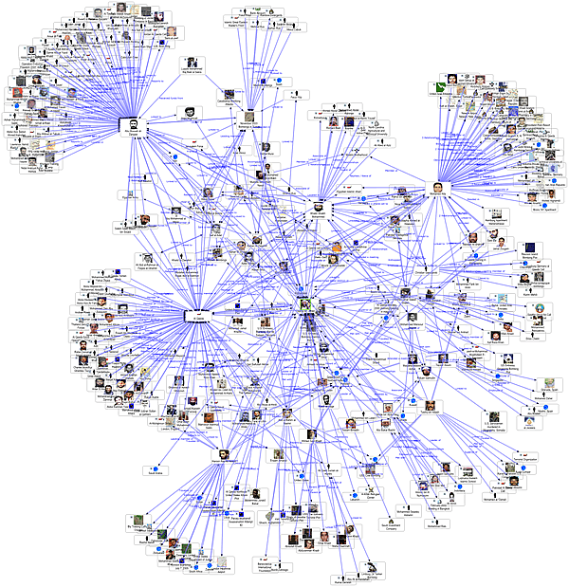
Social Media Friendship Network
Hub: a node that has significantly more connections than the average
Cluster: densely connected community
Link weight:
unweighted, single connection (either friend or not)
weighted, multiple connections (number of exchanged e-mails)
Link direction:
undirected (Facebook friendship)
directed (Twitter following)

Slide 9
SOCIAL NETWORKS
BIOLOGICAL NETWORKS
FINANCIAL NETWORKS
OTHER APPLICATIONS
Epidemics
Brain neural network
Protein interaction
Species network
Medicine/treatment
Cancer research
Friendship
Facebook
Twitter
LinkedIn
Instagram
Collaboration
Actors
Scientists
Co-authorship
Student scholarships
Employer network
Criminal organizations
Terrorist groups
Organized crime
Sexual relationships
Matching problem
Medieval societies
Trade market
Financial transactions
Lender/borrower system
Business relationships
Politics
Elections: opinion influencing
Foreign relations
Ecology
Food chain
species
Environment
Literature
Word relationships
Genre networks
Novel character network
News relationships
Or any other complex system, where you can define a relationship (link) between elements…
INFRASTRUCTURE NETWORKS
COMMUNICATION NETWORKS
Power grid systems
Computer networks
World Wide Web (WWW)
Road traffic
Airline traffic
Mobile communication
E-mail communication

Slide 10
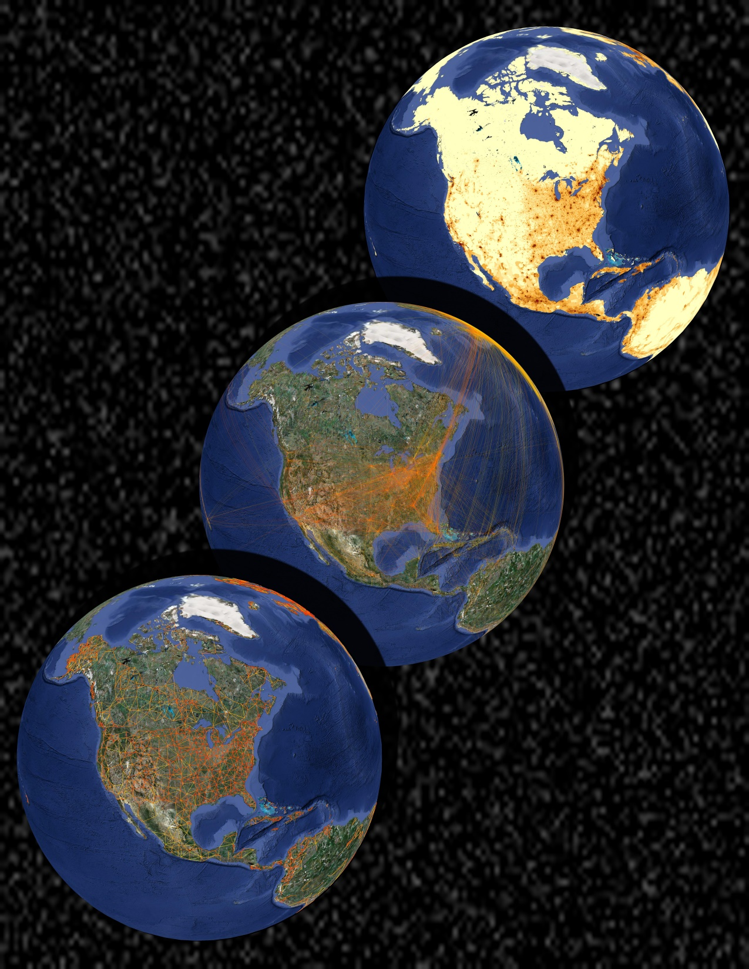
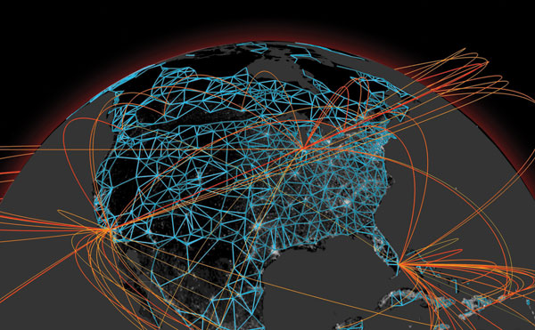
Disease outbreak, epidemics
Data: airline traffic, census data, transportation data
Goal: model and predict the spread of epidemics
Real-time forecasting of epidemic spreading at the global scale
GLEaMViz
Software system for the simulation of infectious diseases on a global scale.
http://www.gleamviz.org/simulator/
Population
Airline
The blue network represents short-range commuting flows by car, train and other means of transportation and transport infrastructures. Yellow-to-red lines denote airline flows for a few selected cities; red corresponds to greater traffic intensity. Population density is identified on the grey/white colour scale, with white corresponding to areas of higher density. All features in this map were obtained from real data.
Commuting
by Bruno Gonçalves and Alessandro Vespignani

Slide 11
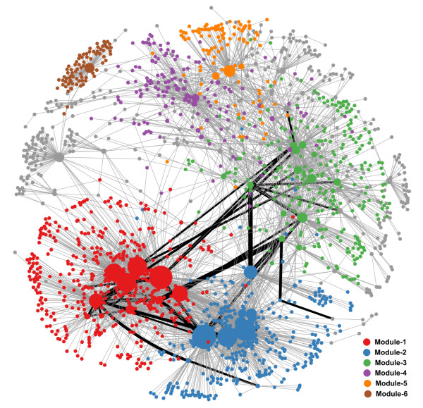
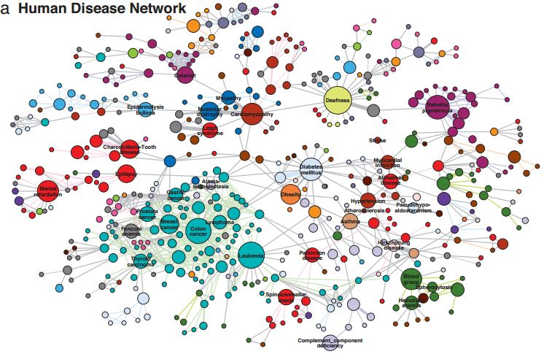
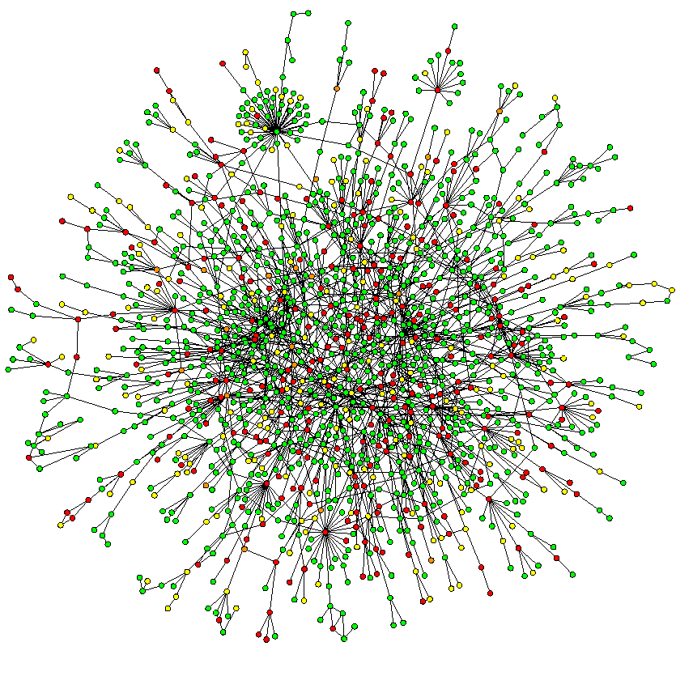
Biological networks
Gene regulatory network
c
Protein interaction network
Protein interaction network
The human disease network
Kwang-Il Goh, Michael E. Cusick, David Valle, Barton Childs, Marc Vidal, and Albert-László Barabási
PNAS 2007

Slide 12
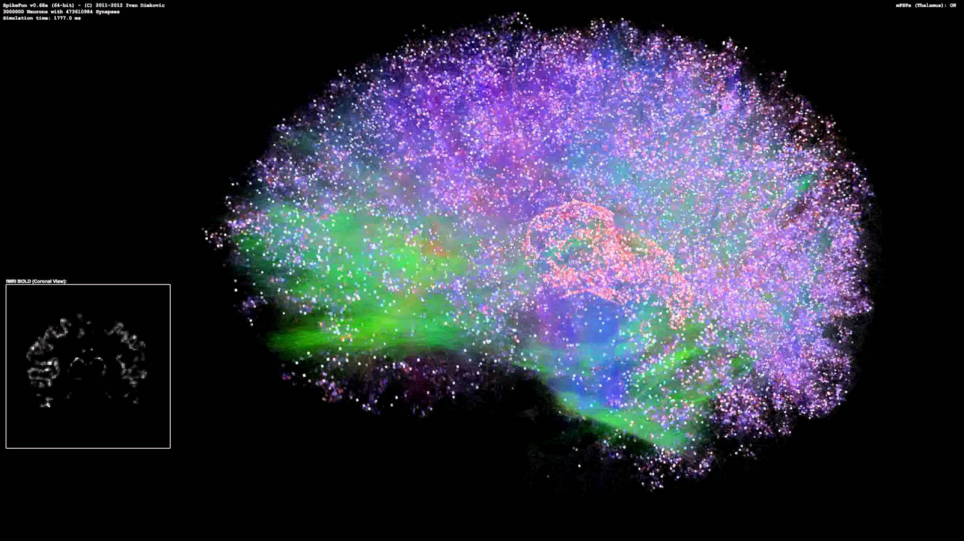
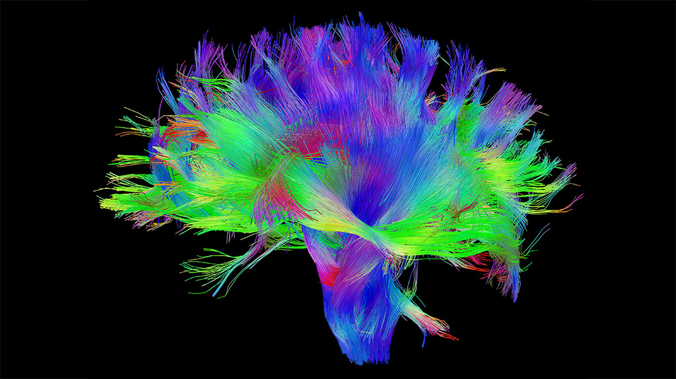
Brain networks
Data: brain DW-MRI
Goal: study brain structure and function, diseases (Alzheimer, dementia, etc.)
Simulated Thalamocortical Brain Network 6 - 3D View, 3 Million Neurons, 476M Synapses
A "connectome," or map of neural pathways and wires, of a human brain(Credit: Human Connectome Project)

Slide 13

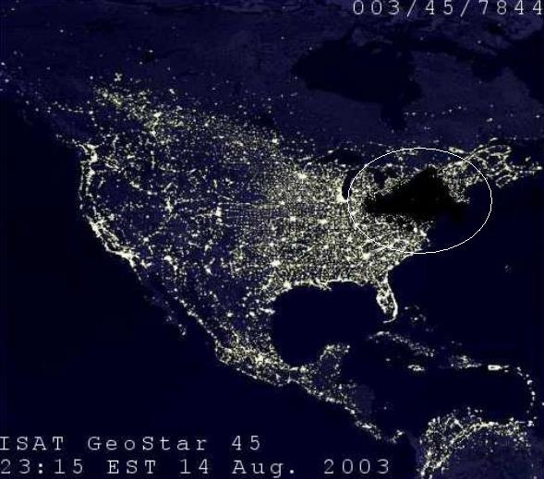

Powergrid network
Data: UCTE (Union of the Coordination of the Transmission of Electricity) European powergrid data
Goal: study cascading failures and mitigation strategies
A cascading failure is a failure in a system of interconnected parts in which the failure of a part can trigger the failure of successive parts.
Important vulnerability of networked systems.
Can occur in:
Biological systems
Infrastructure networks
Financial systems
Power grids:
one element fails
shifts its load to its neighboring elements; those elements are then pushed beyond their capacity
some become overloaded and fail
their loads are shifted onto their neighbors
Blackout simulation in the European powergrid
Cascading Failures in Spatially-Embedded Random Networks
A. Asztalos, S. Sreenivasan , B. K. Szymanski, G. Korniss
PLoS ONE 9(1): e84563 (2014)
Power blackout in New York City (2012)

Slide 14
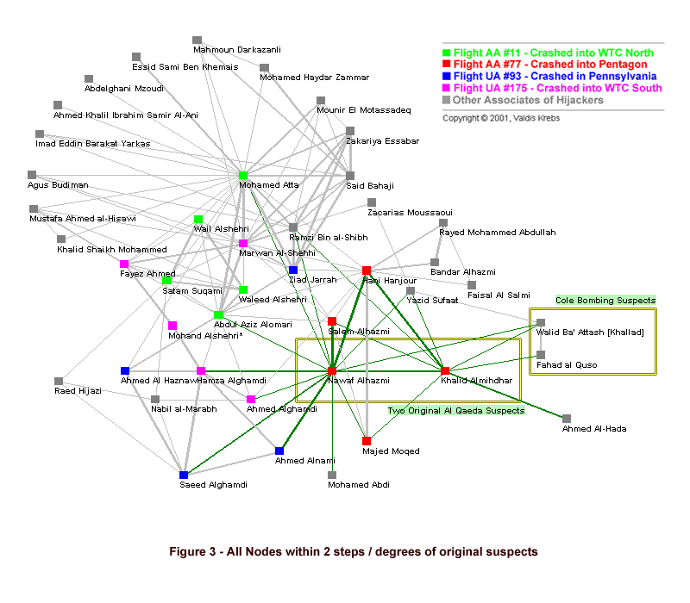
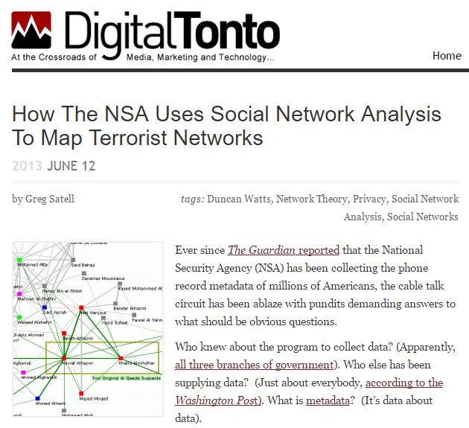
Terrorism, organized crime networks
9/11 Terrorist Group
All 19 hijackers were within 2 steps of the two original suspects uncovered in 2000
Social network metrics reveal Mohammed Atta emerging as the local leader
Uncloaking Terrorist Networks, Valdis Krebs
http://firstmonday.org/ojs/index.php/fm/article/view/941/863
http://www.orgnet.com/prevent.html
http://www.digitaltonto.com/2013/how-the-nsa-uses-social-network-analysis-to-map-terrorist-networks/

Slide 15
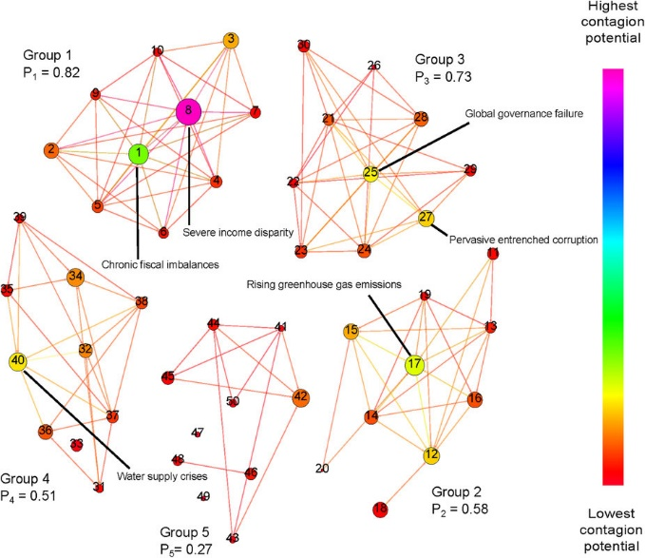
Global risk network
Risks threatening modern societies form an intricately interconnected network that often underlies crisis situations.
Goal: study how risk materializations in distinct domains influence each other.
Data: WEF Report on Global Risks
Each node is sized proportionally to its internal failure probability while node color corresponds to its total contagion potential. The number of edges in each group shows the intra-group connectivity. The nodes with the highest congestion potential are identified by name.
Failure dynamics of the global risk network
B. K. Szymanski, X. Lin, A. Asztalos & S. Sreenivasan
Scientific Reports 5, 10998

Slide 16
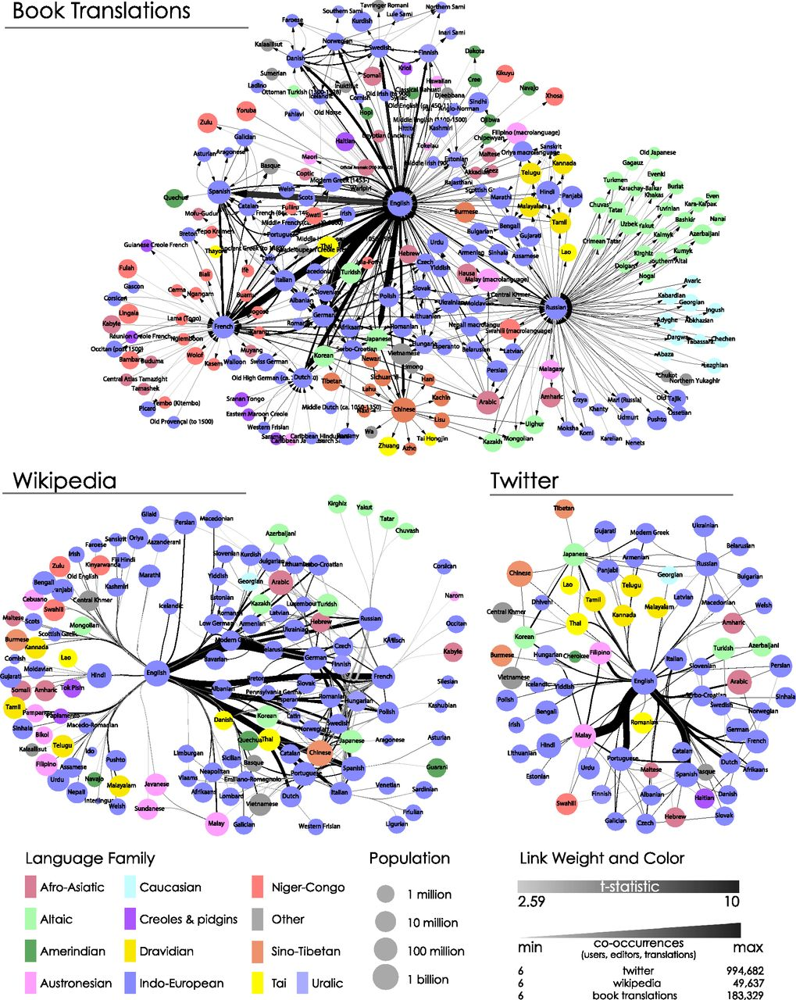
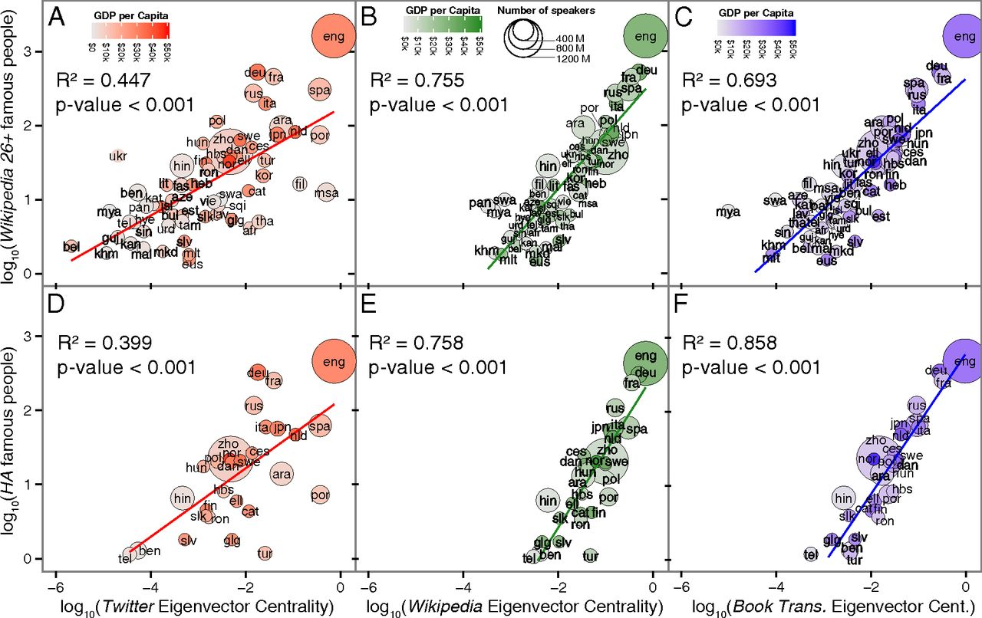

Global language network (gln)
Data: Twitter, Wikipedia, UNESCO book translations
Goal: study the importance of languages and their impact
The position of a language in the GLN and the global impact of its speakers
The position of a language in the GLN contributes to the visibility of its speakers and the global popularity of the cultural content they produce.
Links that speak: The global language network and its association with global fame.
S. Ronen, B. Gonçalves, K. Z. Hu, A. Vespignani, S. Pinker, and C. A. Hidalgo
PNAS 2014;111:E5616-E5622

Slide 17
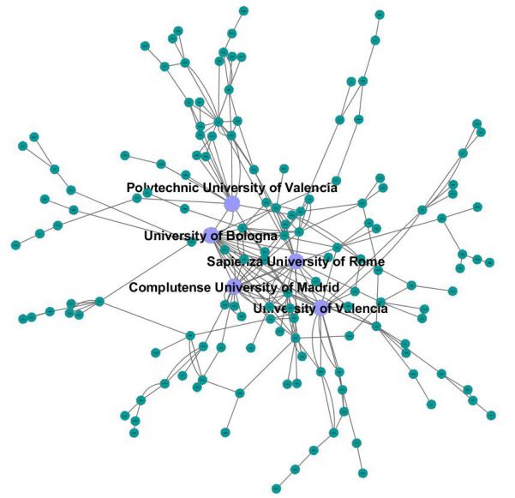
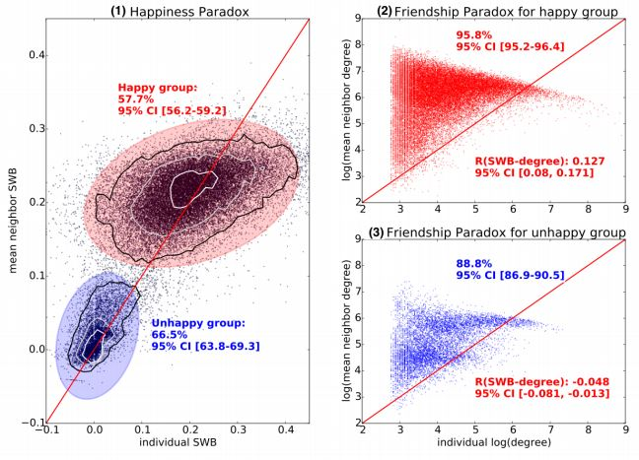
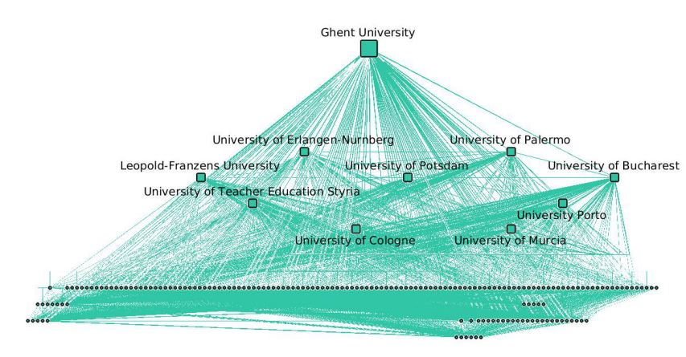
Friendship networks
collaboration networks
Data: Twitter
Goal: study the Happiness Paradox (most individuals in social networks experience a so-called Friendship Paradox: they are less popular than their friends on average)
Data: European Erasmus scholarships
Goal: study the academic collaborations among universities through student mobility
The 5 most densely connected universities in Europe
Top 10 universities of highest number of connections
Popular individuals are indeed happier and a majority of individuals experience a significant Happiness paradox.
The happiness paradox: your friends are happier than you
J. Bolen, B. Gonçalves, I. van de Leemput, G. Ruan arXiv: 1602.02665
Topology of the Erasmus student mobility network
A. Derzsi, N. Derzsy, E. Kaptalan and Z. Neda
Physica A. 2011;390(13):2601–2610

Slide 18
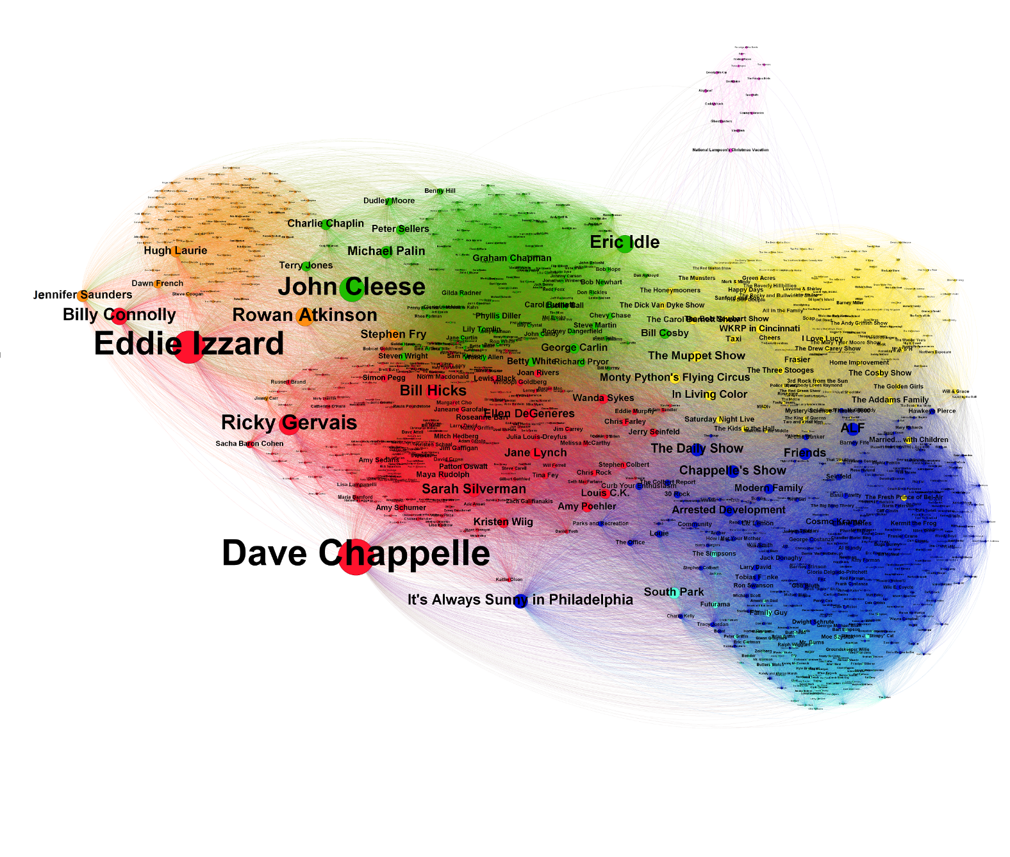
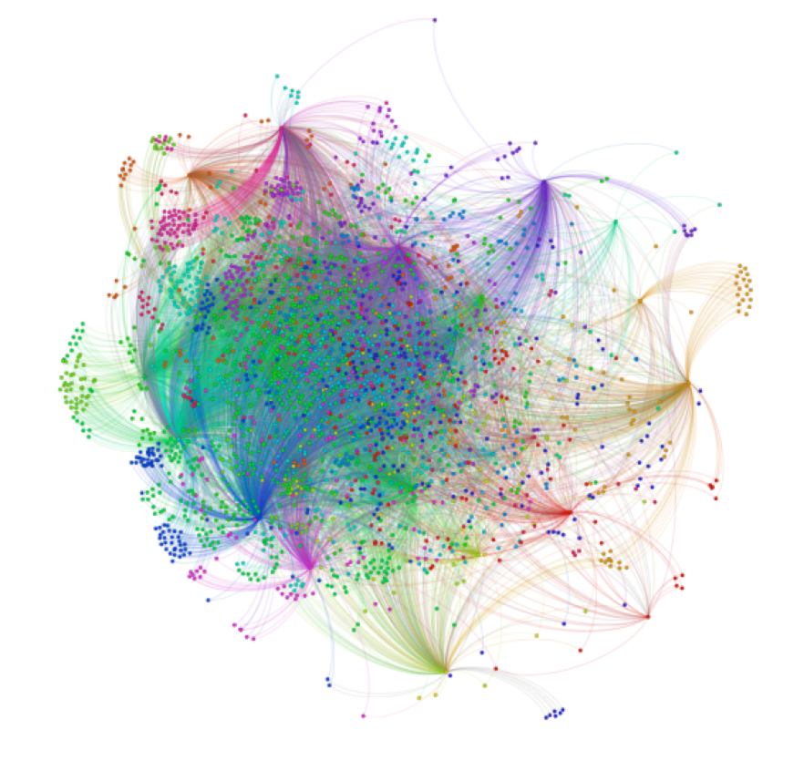
Other social networks
A Ranker World of Comedy Opinion Graph: Who Connects the Funny Universe?
Oscar Award Race - Hollywood Celebrity Network
Data: Twitter
Goal: find the hub in the network
Data: Twitter
Goal: study the effect of opinion of the most influential groups on social media tweeting about the Oscars
Answer: Dave Chappelle
http://blog.ranker.com/a-ranker-opinion-graph-of-the-domains-of-the-world-of-comedy/#.WD9mePkrLIU
http://echeloninsights.tumblr.com/post/111791840768/what-data-can-tell-us-about-the-oscar-race-and

Slide 19
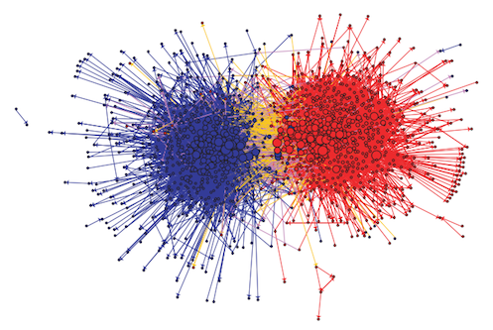
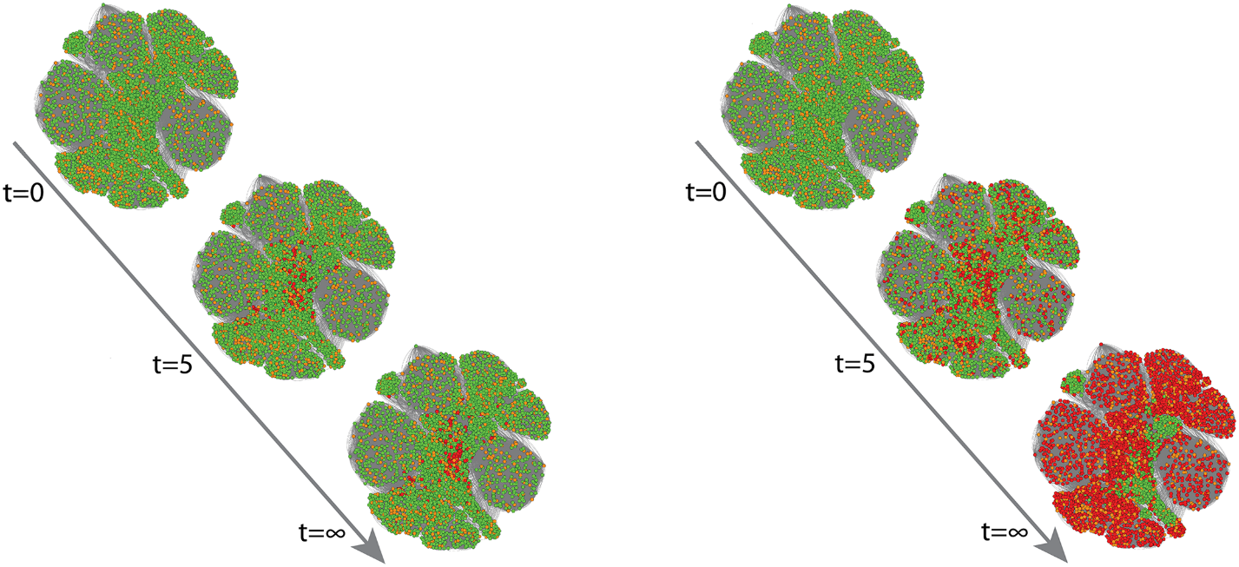
Opinion influencing And politics in social networks
Data: Facebook
Goal: study the spread of opinions on social networks
Online communication between left-wing (blue) and right-wing (red) political blogs
Inactive nodes
Initiators
Active nodes
Can be used for product marketing, politics, etc.
“They are almost entirely divided into two separate networks: an echo chamber of like-minded individuals.”
Image by Lada Adamic & Natalie Glance
The Impact of Heterogeneous Thresholds on Social Contagion with Multiple Initiators
P. D. Karampourniotis, S. Sreenivasan, B. K. Szymanski, G. Korniss
PLoS ONE 10(11): e0143020 (2015)

Slide 20
Theoretical research on networks
A few of the multitude of topics studied on networks…
Network controlling, monitoring, influencing
Network resilience against random failures or attacks
Network dynamics
Information flow on networks
Opinion formation and influencing
Cascading failures in networks
Clustering analysis, community detection
Multilayer networks

